Slide 1
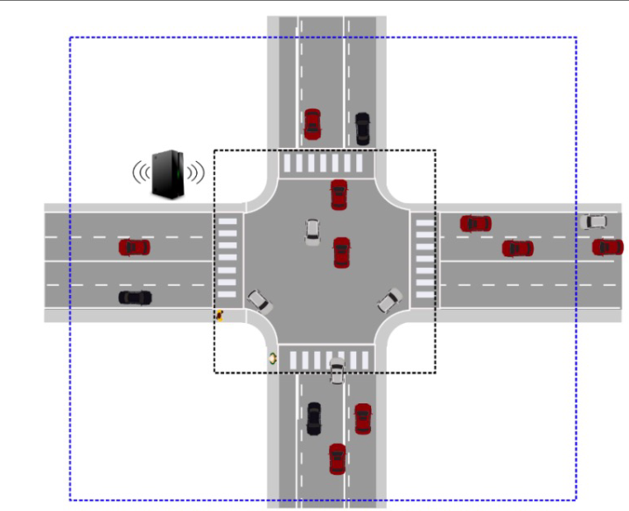
Autonomous Intersection system
By:
Ahmed Hemly
Kashif Raza
Ammar Imran Khan

Slide 2
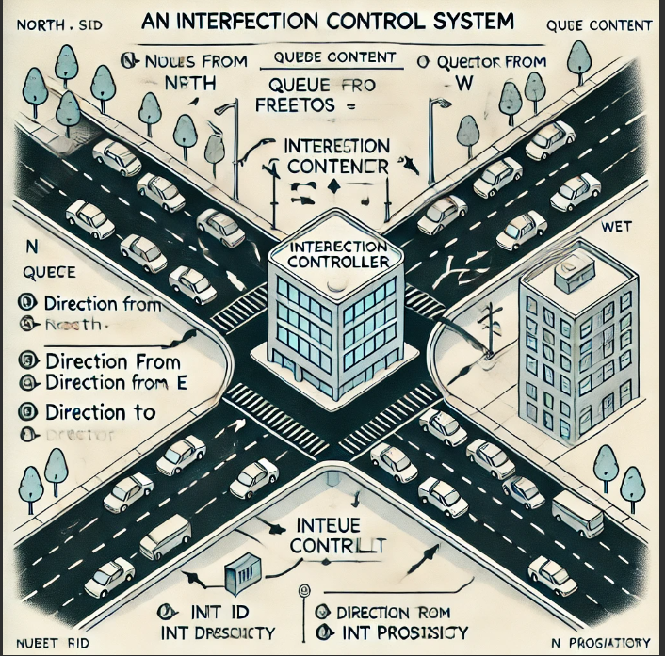
MOTIVATION
Autonomous Vehicles (AVs)
Transforming transportation
Enhancing road safety, reducing traffic congestion, and improving
convenience.
Intersection Challenges:
Critical convergence points for traffic
Need for precise coordination to avoid collisions and minimize delays
Traditional systems are inadequate for AVs' dynamic decision-making
Proposed Solution:
Autonomous traffic intersection controller using Vehicle-to-Infrastructure (V2I) communication

Slide 3
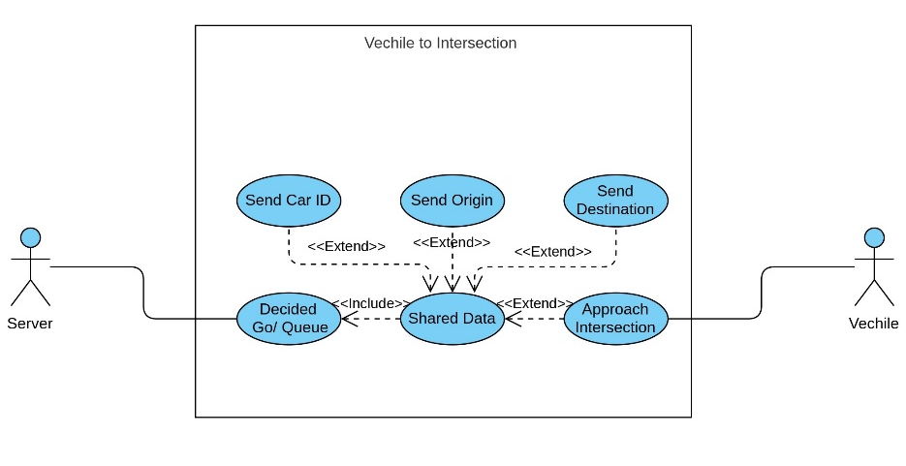
Software-MODELLING Use Case Diagram

Slide 4
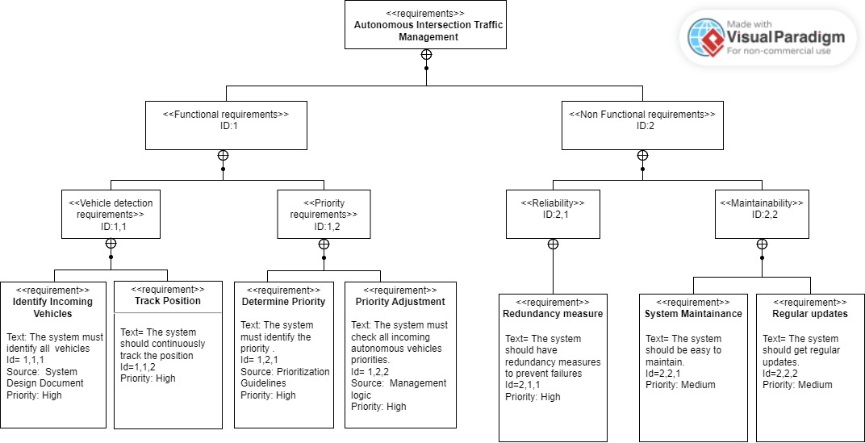
Software-MODELLING Requirement Diagram

Slide 5
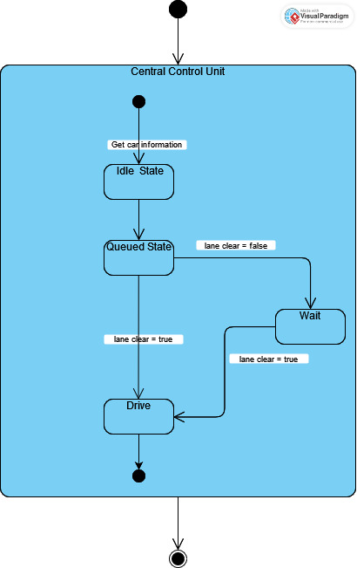
Software-MODELLING STATE MACHINE Diagram

Slide 6
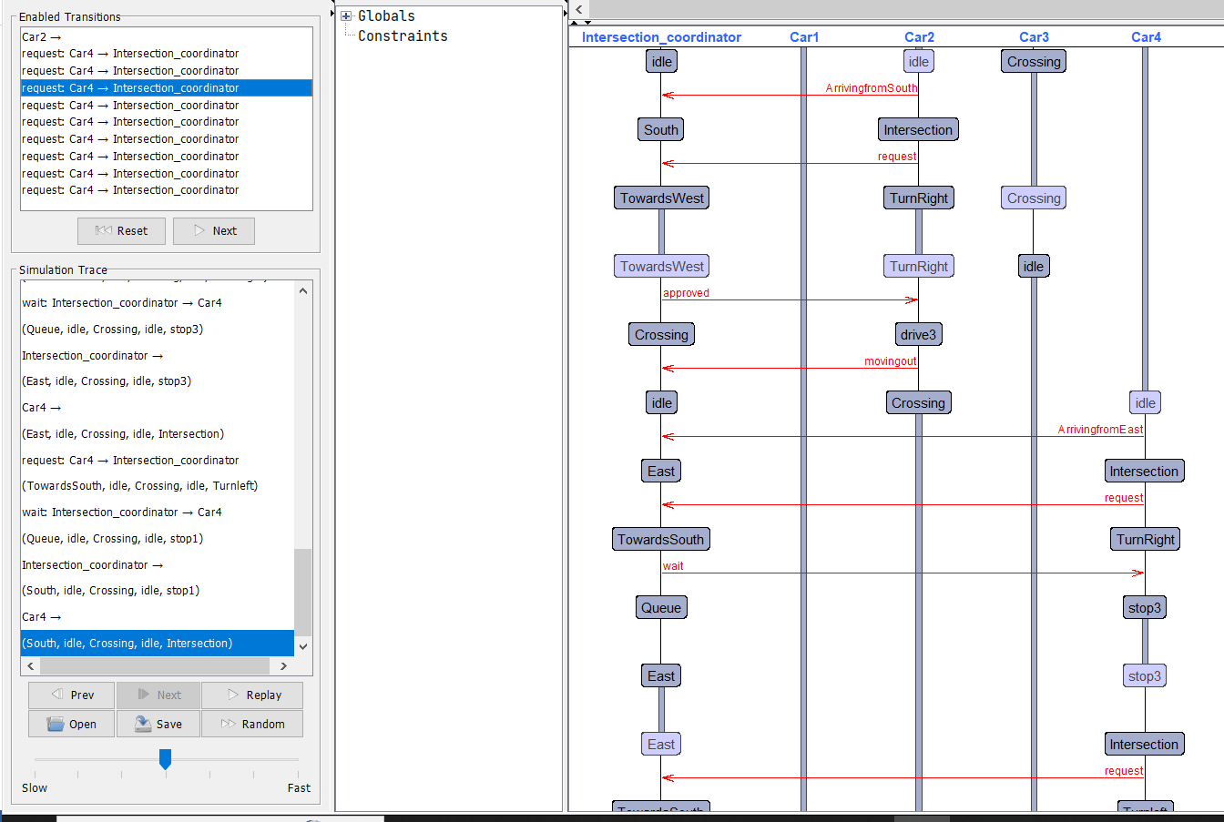
UpPaal Implementation Simulation

Slide 7
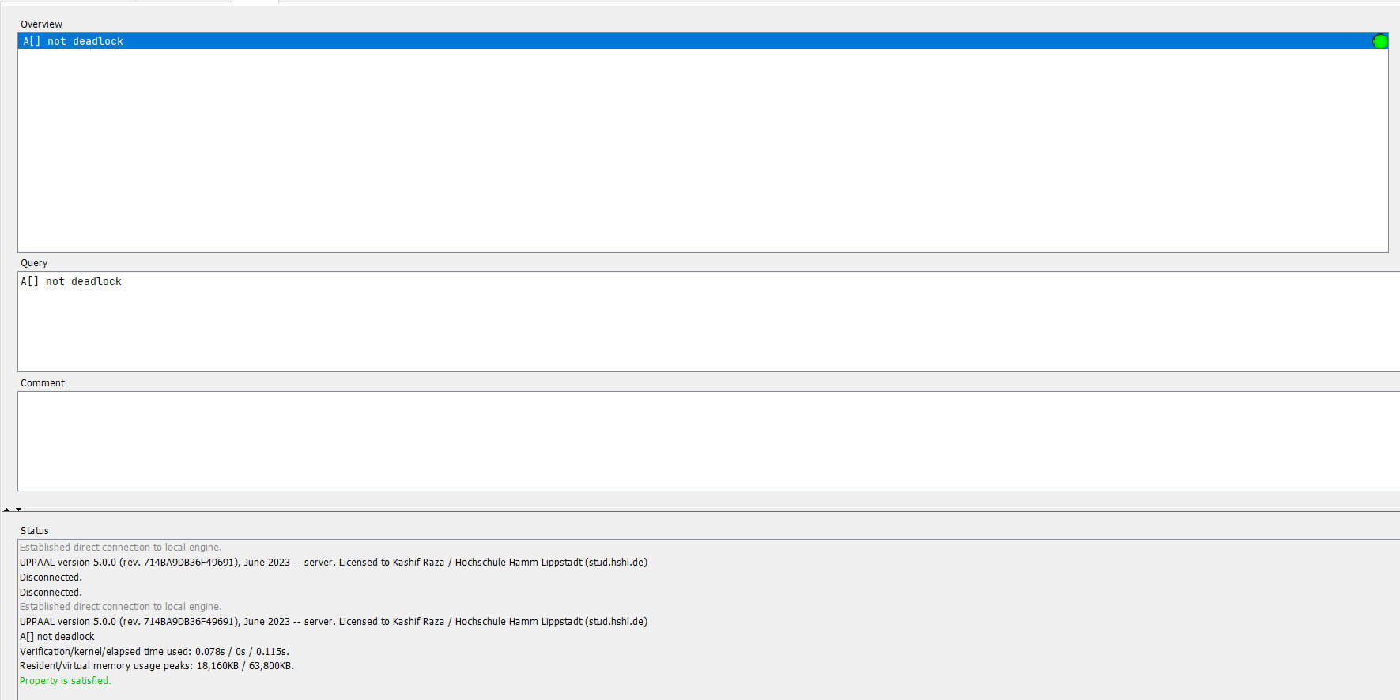
UpPaal Implementation VERIFICATION

Slide 8
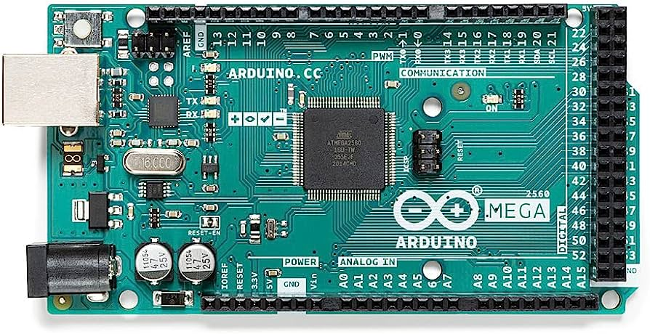
FREERTOS Implementation Hardware Selection
Reason to use Arduino Mega
Arduino IDE Framework
More Flash Memory: 256 KB , allowing for larger and more complex programs.
Greater SRAM: 8 KB , providing more space for variables and better handling of tasks.
Increased EEPROM: 4 KB enabling more non-volatile storage.

Slide 9
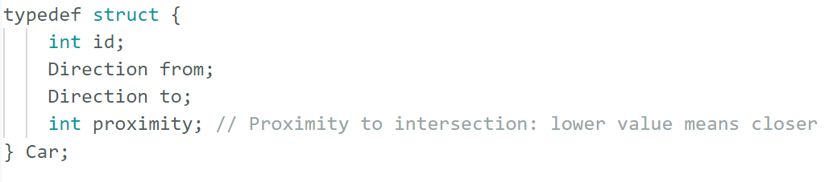
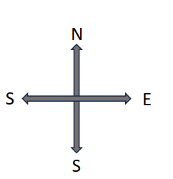
FREERTOS Implementation
Dynamic Priority Scheduling Algorithm
Cars with Different priorities
Controller

Slide 10
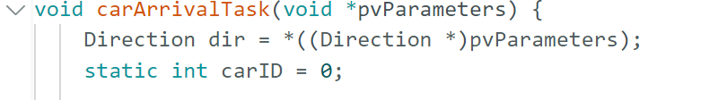
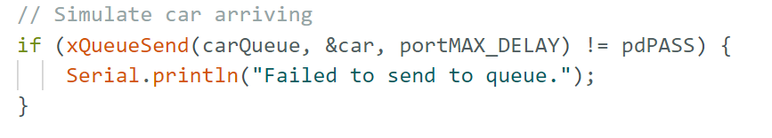
FREERTOS Implementation
Cast “pvParameters” to get the arrival direction (`dir`).
Initialize static “carID” for unique car IDs.
Create and configure a “Car” instance with ID, direction, destination, and proximity.
Send the car to “carQueue”, and print details or an error message.

Slide 11
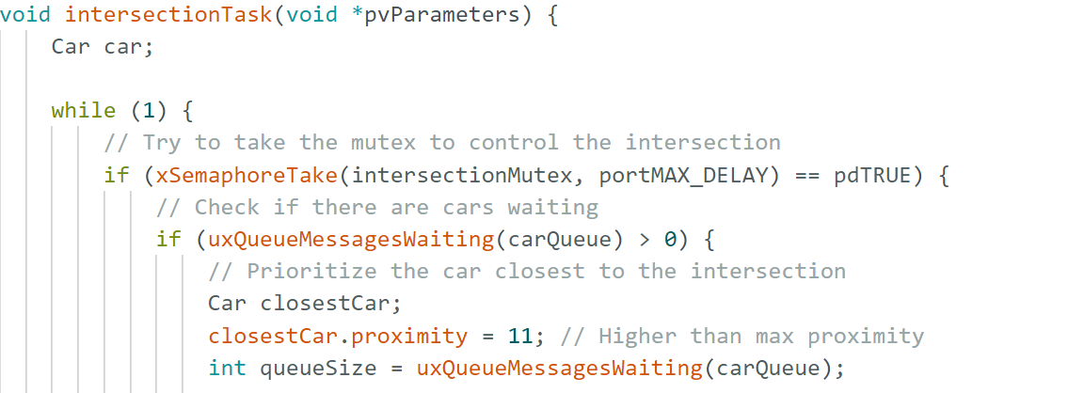
FREERTOS Implementation
Take the mutex “intersectionMutex” to control access to the intersection.
Check if there are cars waiting in the queue “carQueue”.
Identify and prioritize the car with the closest proximity to the intersection.
Print details of the prioritized car and simulate its passage through the intersection.
Release the mutex and wait briefly before checking the queue again.

Slide 12
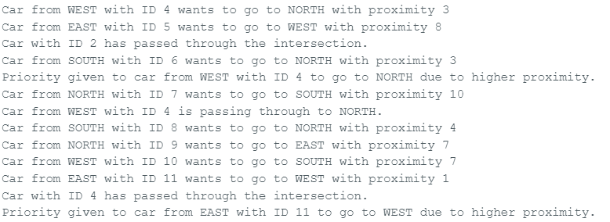
FREERTOS Implementation Results

Slide 13
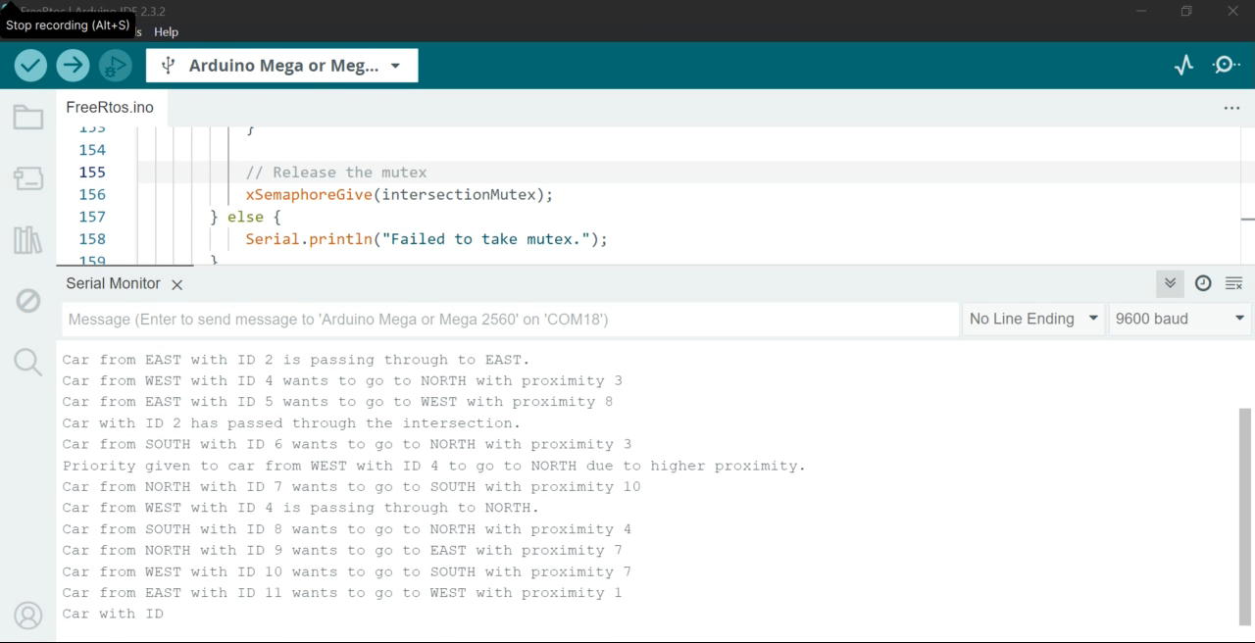
FREERTOS Implementation

Slide 14
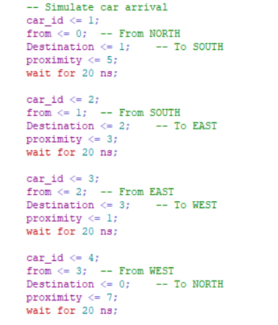
VHDL Implementation VHDL Code snippets

Slide 15
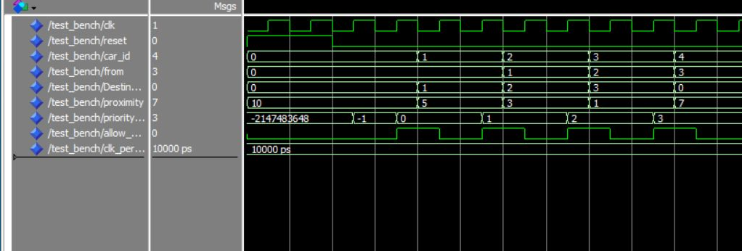
VHDL Implementation Simulation

Slide 16
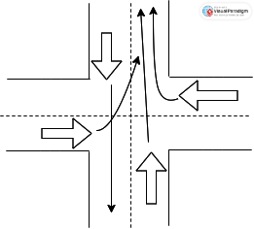
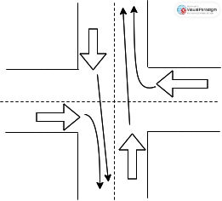
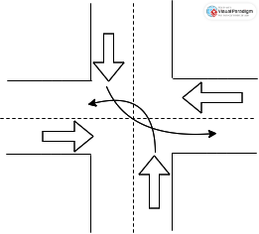
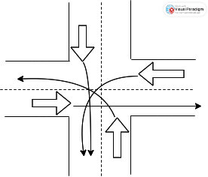
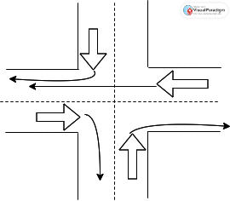
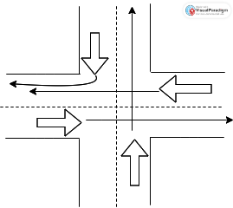
Problematic scenarios

Slide 17
CONCLUSION

